Slide 1
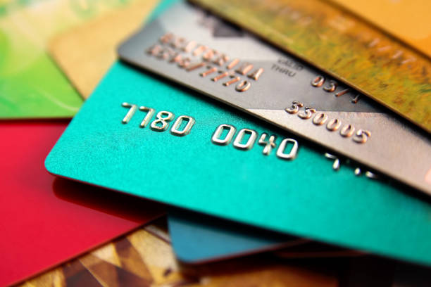
Credit Card Fraud Detection using ML
Capstone Project by Imran Tan

Slide 2
Intro
Background: Bachelor’s Degree in Accountancy from NTU
Work experience: 2.5 years of financial audit experience at a Big4
Main skills: Accounting, Financial reporting, Financial Audit, Controls testing
New skills: Python, Machine Learning, SQL, Data analysis
Interests: Machine Learning in providing business solutions

Slide 3
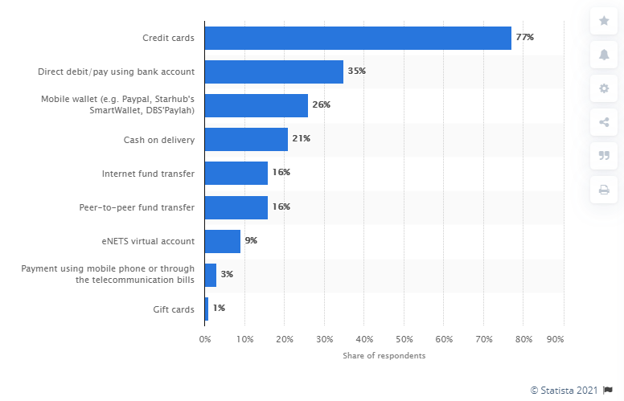
Survey on credit card usage in the last 3 months
Notes:
According to a survey in Singapore as of December 2019, approximately 77 percent of the respondents in the country stated that they have used credit cards as payment method for their online purchases at least once in the last three months. Other popular payment methods among respondents were direct debit and mobile wallet, such as Paypal, Starhub's SmartWallet and DBS' Paylah.

Slide 4
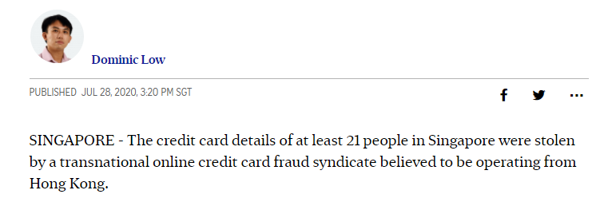
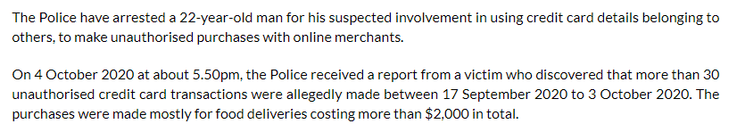
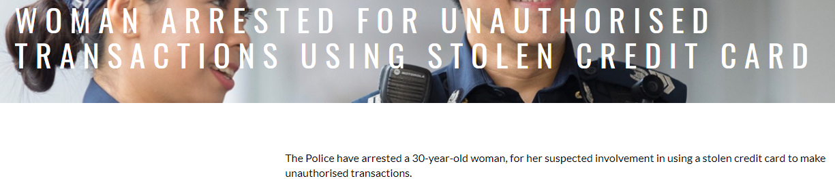
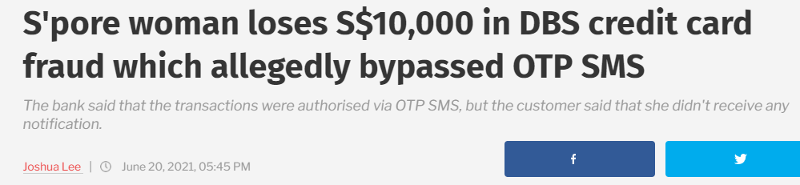
Notes:
According to a survey in Singapore as of December 2019, approximately 77 percent of the respondents in the country stated that they have used credit cards as payment method for their online purchases at least once in the last three months. Other popular payment methods among respondents were direct debit and mobile wallet, such as Paypal, Starhub's SmartWallet and DBS' Paylah.

Slide 5
Types of credit card fraud
Card-present (CP) scenarios - refer to scenarios where a physical card is needed.
  Lost or stolen card
  Counterfeited card
  Card not received
Card-not-present (CNP) scenarios - refers to scenarios where a physical card does not need to be used.
  Illegally obtained payment credentials via phishing, scam text message
Notes:
Card-present (CP) scenarios - refer to scenarios where a physical card is needed, such as transactions at a store (also referred to as a point-of-sale - POS) or transactions at a cashpoint (for instance at an automated teller machine - ATM).
Card-not-present (CNP) scenarios, refers to scenarios where a physical card does not need to be used, which encompasses payments performed on the Internet, by phone, or by mail.

Slide 6
Credit card fraud detection system
Terminal
Transaction-Blocking Rules
Scoring Rules
Data-Driven Model (DDM)
Investigators
Notes:
Card-present (CP) scenarios - refer to scenarios where a physical card is needed, such as transactions at a store (also referred to as a point-of-sale - POS) or transactions at a cashpoint (for instance at an automated teller machine - ATM).
Card-not-present (CNP) scenarios, refers to scenarios where a physical card does not need to be used, which encompasses payments performed on the Internet, by phone, or by mail.

Slide 7
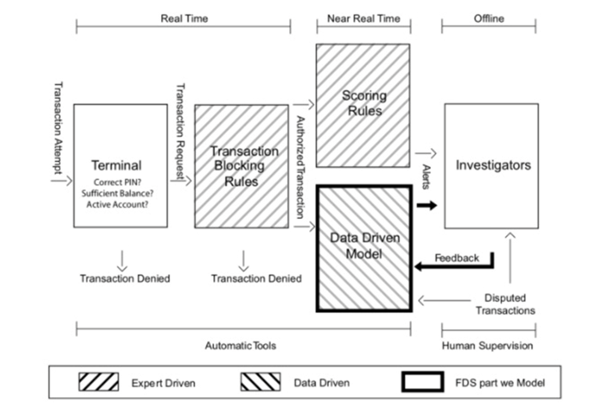
  Performs conventional security checks
  Analyzing credit card transactions
  Statements that Block transaction requests
  Assigns a fraud score
  Machine Learning Model
Notes:
According to a survey in Singapore as of December 2019, approximately 77 percent of the respondents in the country stated that they have used credit cards as payment method for their online purchases at least once in the last three months. Other popular payment methods among respondents were direct debit and mobile wallet, such as Paypal, Starhub's SmartWallet and DBS' Paylah.

Slide 8
The Problem
Credit card fraud detection (CCFD) is like looking for needles in a haystack.
It is now almost impossible for a human specialist to detect meaningful patterns from transaction data.
ML techniques applied on CCFD are relatively new
Notes:
Credit card fraud detection (CCFD) is like looking for needles in a haystack. It requires to find, out of millions of daily transactions, which ones are fraudulent.
Due to the ever-increasing amount of data, it is now almost impossible for a human specialist to detect meaningful patterns from transaction data. For this reason, the use of machine learning techniques is now widespread in the field of fraud detection, where information extraction from large datasets is required

Slide 9
How can we use Machine Learning techniques to detect fraud?
Notes:
Credit card fraud detection (CCFD) is like looking for needles in a haystack. It requires to find, out of millions of daily transactions, which ones are fraudulent. Due to the ever-increasing amount of data, it is now almost impossible for a human specialist to detect meaningful patterns from transaction data. For this reason, the use of machine learning techniques is now widespread in the field of fraud detection, where information extraction from large datasets is required

Slide 10
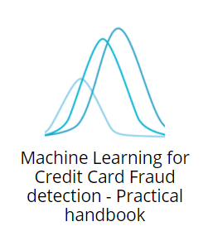
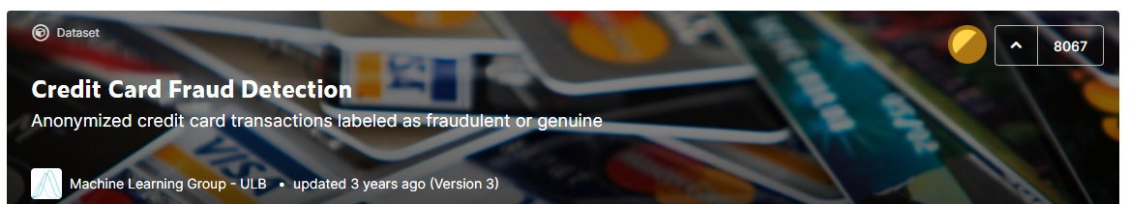
Background of the data
The dataset is a transaction data simulator of legitimate and fraudulent transactions which mimics a real-world dataset.
The dataset was generated in 2021 by a collaboration between Machine Learning Group, University of Brussels, Belgium and Worldline.
Machine Learning Group previously released the only publicly available dataset 3 years ago.
Notes:
For obvious confidentiality reasons, real-world credit card transactions cannot be publicly shared. There exists only one publicly shared dataset, which was made available on Kaggle.
Despite its limitations (only two days of data, and obfuscated features), the dataset has been widely used in the research literature, and is one of the most upvoted and downloaded on Kaggle.

Slide 11
The Features I
Transaction ID: A unique identifier for the transaction
Date & Time: Date and time at which the transaction occurs
Customer ID: The identifier for the customer. Each customer has a unique identifier
Terminal ID: The identifier for the merchant (or more precisely the terminal). Each terminal has a unique identifier
Transaction Amount: The amount of the transaction.
The Fraud Label: A binary variable, with the value 0 for a legitimate transaction, or the value 1 for a fraudulent transaction.
Notes:
Our focus will be on the most essential features of a transaction. In essence, a payment card transaction consists of any amount paid to a merchant by a customer at a certain time. The six main features that summarise a transaction therefore are:
The transaction ID: A unique identifier for the transaction
The date and time: Date and time at which the transaction occurs
The customer ID: The identifier for the customer. Each customer has a unique identifier
The terminal ID: The identifier for the merchant (or more precisely the terminal). Each terminal has a unique identifier
The transaction amount: The amount of the transaction.
The fraud label: A binary variable, with the value 00 for a legitimate transaction, or the value 11 for a fraudulent transaction.

Slide 12
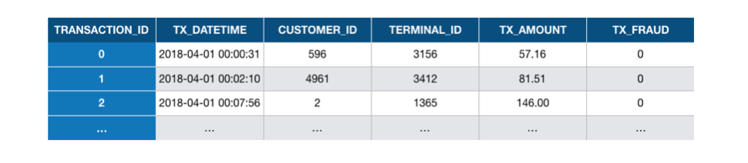
The Features II
The dataset contains the essential features that characterize a payment card transaction.
Notes:
The simulated dataset generated in the previous section is simple. It only contains the essential features that characterize a payment card transaction.
What each row essentially tells us is that, at 00:00:31, on the 1st of April 2018, a customer with ID 596 made a payment of a value of 57.19 to a merchant with ID 3156, and that the transaction was not fraudulent.
Then, at 00:02:10, on the 1st of April 2018, a customer with ID 4961 made a payment of a value of 81.51 to a merchant with ID 3412, and that the transaction was not fraudulent. And so on.

Slide 13
fraud scenarios in the data
Scenario 1:
A scenario which provides an obvious fraud pattern that should be detected by any baseline fraud detector.
Scenario 2:
A scenario which simulates a criminal use of a terminal, through phishing for example.
Scenario 3:
A scenario which simulates a card-not-present fraud where the credentials of a customer have been leaked.
Notes:
Scenario 1: Any transaction whose amount is more than 220 is a fraud. This scenario is not inspired by a real-world scenario. Rather, it will provide an obvious fraud pattern that should be detected by any baseline fraud detector. This will be useful to validate the implementation of a fraud detection technique.
Scenario 2: Every day, a list of two terminals is drawn at random. All transactions on these terminals in the next 28 days will be marked as fraudulent. This scenario simulates a criminal use of a terminal, through phishing for example. Detecting this scenario will be possible by adding features that keep track of the number of fraudulent transactions on the terminal. Since the terminal is only compromised for 28 days, additional strategies that involve concept drift will need to be designed to efficiently deal with this scenario.
Scenario 3: Every day, a list of 3 customers is drawn at random. In the next 14 days, 1/3 of their transactions have their amounts multiplied by 5 and marked as fraudulent. This scenario simulates a card-not-present fraud where the credentials of a customer have been leaked. The customer continues to make transactions, and transactions of higher values are made by the fraudster who tries to maximize their gains. Detecting this scenario will require adding features that keep track of the spending habits of the customer. As for scenario 2, since the card is only temporarily compromised, additional strategies that involve concept drift should also be designed.

Slide 14
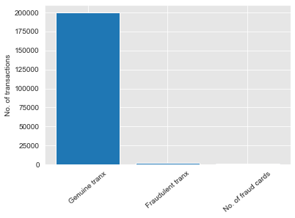
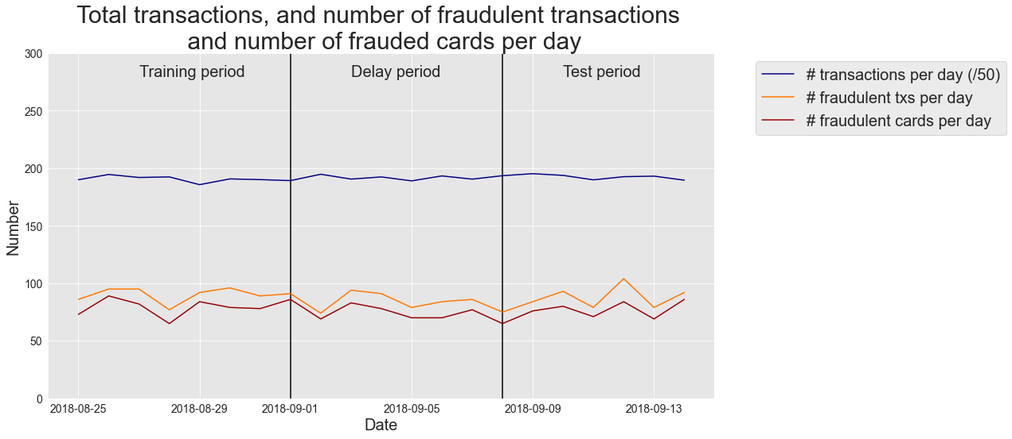
Analyse the data
      Data set is heavily imbalanced
      About 10,000 transactions per day
      Test period will be set 1 week after the Training period

Slide 15
Feature Engineering
  Terminal ID
  Risk Encoding:
  Assign a risk score to a terminal ID
  Date/Time
  One-hot encoding:
  0 – Weekday & 1 – Weekend
  0 - Morning & 1 – Night
  Customer ID
  Frequency & Monetary:
  No. of transactions that occur
  Average amount spent

Slide 16
Objective of the model
For a fraud detection system, the best model can be defined as the model that has the highest expected fraud detection performances on future transactions.
Notes:
Defining a training set (historical data) and a test set (new data). The training set is the subset of transactions that are used for training the prediction model. The test set is the subset of transactions that are used to assess the performance of the prediction model.
Training a prediction model: This step consists in using the training set to find a prediction model able to predict whether a transaction is genuine or fraudulent. We will rely for this task on the Python sklearn library, which provides easy-to-use functions to train prediction models.
Assessing the performance of the prediction model: The performance of the prediction model is assessed using the test set (new data).

Slide 17
Building the model
Cleaning & defining the training set and test set
Training prediction models
Assessing the performance of the prediction models
Notes:
Defining a training set (historical data) and a test set (new data). The training set is the subset of transactions that are used for training the prediction model. The test set is the subset of transactions that are used to assess the performance of the prediction model.
Training a prediction model: This step consists in using the training set to find a prediction model able to predict whether a transaction is genuine or fraudulent. We will rely for this task on the Python sklearn library, which provides easy-to-use functions to train prediction models.
Assessing the performance of the prediction model: The performance of the prediction model is assessed using the test set (new data).

Slide 18

Which metrics to choose?
Missing a fraudulent transaction is usually considered more costly than raising a false alert on a legitimate transaction.
Notes:
The most straightforward way to assess the performance of a binary classifier is by computing the accuracy score.
It is usually a good indicator of a classifier performance for balanced datasets.
However, for an imbalanced dataset and a cost-sensitive problem such as fraud detection, using the accuracy score has some shortcomings.
For example, accuracy as a metric on an imbalanced dataset would have a high accuracy simply because most transactions are not fraudulent.
Hence, accuracy is a poor metric in this case and this is widely acknowledged in the fraud detection literature, and other performance metrics are therefore commonly used.

Slide 19
Metrics selection
AUC ROC
Average Precision (AP)
Notes:
A fraud detection system aims at optimizing two conflicting goals. On the one hand, the system should maximize the detection of fraudulent transactions, a metric known as recall. On the other hand, it should also minimize the number of false positives, that is, the number of genuine transactions which are incorrectly predicted as frauds. Unless a perfect classifier can be designed, maximizing the recall comes at a cost in terms of false positives. The cost structure of a fraud detection system is however complex, if not impossible, to determine.
A common approach to circumvent this conflicting goal is to assess the recall and false positive rates for all possible decision thresholds. The resulting function is the Receiving Operating Characteristic (ROC) curve. The area under the ROC curve (known as AUC ROC) is the most widely used metric to assess the performance of fraud detection systems. This chapter highlighted that the AUC ROC is however poorly adapted to class imbalanced problems such as fraud detection. Two other metrics, the Average Precision (AP), and the daily Card Precision top-kk (CP@k) were motivated to better characterize the performances of a CCFD.
The AUC ROC, AP, and CP@k are complementary. The AUC ROC reflects the accuracy of the detection system for all possible thresholds. The AP also reflects the accuracy of the detection system for all possible thresholds but gives more importance to regions of the decision thresholds where the precision remains high. Finally, the CP@k provides a more concrete metric for CCFD, by assessing the average daily precision of the system, assuming that a maximum of kk cards can be checked daily by investigators.
Due to their complementarity, we recommend assessing the performance of a fraud system by using these three performance measures. All the techniques and methods presented in the next chapters will be assessed with these measures
Note that all three metrics provide values in the interval [0,1] and that higher values mean better performances.

Slide 20
ML tools
Logistic regression (LR)
Decision Trees (DT)
Random Forests (RF)
XGBoost (XGB)
Notes:
Logistic regression (LR) & Decision Trees (DT) - simplicity and interpretability
Random Forests (RF) & Boosting, - currently considered to be state-of-the-art in terms of performance
Neural Networks/Deep Learning (NN/DL) - provide promising research directions.

Slide 21
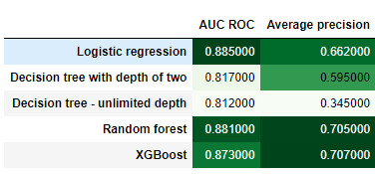
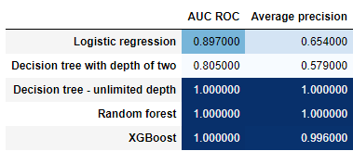
Model comparisons
Test results
Training results

Slide 22
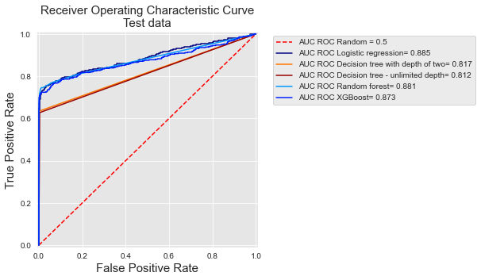
Model comparisons
– ROC AUC
Lowest performer – Decision Tree 0.812
Highest performer - Logistic Regression 0.885

Slide 23
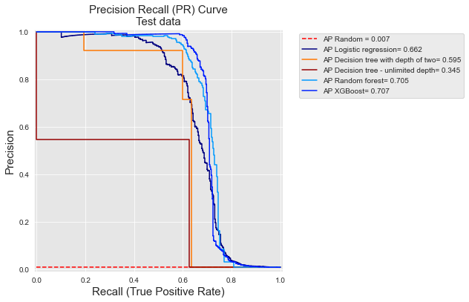
Model comparisons –
PR Curve
Lowest performer – Decision Tree 0.345
Highest performer – XGBoost 0.707
Notes:
In a real world context we would want the precision of the number of transactions for investigators to check to be high too.

Slide 24

Which Model to choose?
Validation procedures provide an estimate of the generalization of performance.
What parameters would have provided the best performance on the test set?
Notes:
The most straightforward way to assess the performance of a binary classifier is by computing the accuracy score.
It is usually a good indicator of a classifier performance for balanced datasets.
However, for an imbalanced dataset and a cost-sensitive problem such as fraud detection, using the accuracy score has some shortcomings.
For example, accuracy as a metric on an imbalanced dataset would have a high accuracy simply because most transactions are not fraudulent.
Hence, accuracy is a poor metric in this case and this is widely acknowledged in the fraud detection literature, and other performance metrics are therefore commonly used.

Slide 25
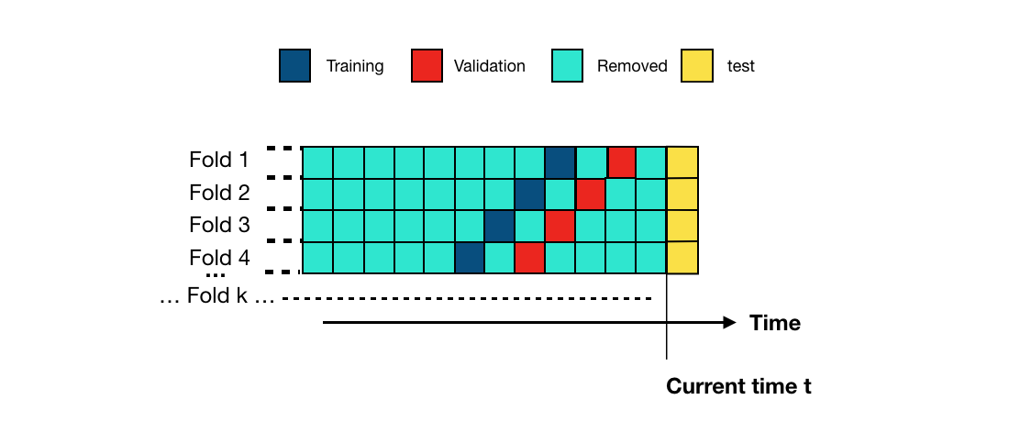
Validation technique
An alternative validation procedure consists in using training sets of similar sizes, taken from older historical data.
The scheme is called prequential validation.
Each fold shifts the training and validation sets by one block in the past.
Notes:
In simple words, this is a variation of a stratified k-fold validation. But with a time element.

Slide 26

Hyperparameter tuning
Default parameters
Best estimated parameters: Parameters that provide the highest performances on the validation set
Optimal parameters: Parameters that provide the highest performances on the test set.
Notes:
The default parameters for each model class are:
Decision tree: max_depth=None.
Logistic regression: C=1.
Random forest: n_estimators=100, max_depth=None.
XGBoost: n_estimators=100, max_depth=2, learning_rate=0.1

Slide 27
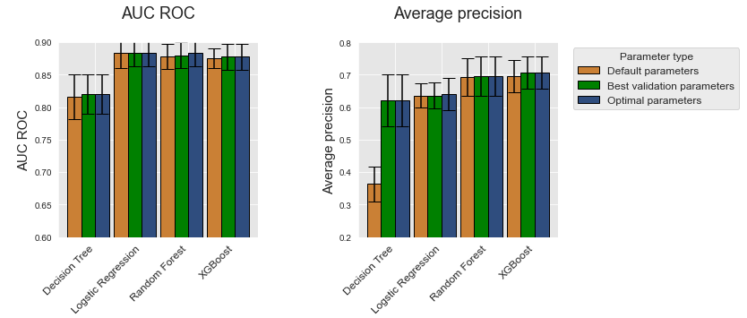
Model results
Similar performances from Logistic Regression, Random Forest 0.883, and XGBoost 0.878 in terms of AUC ROC
XGBoost has the best average precision metric 0.702. Random Forest slightly lower at 0.695
Best performer - XGBoost
Notes:
Similar performances from Logistic Regression, Random Forest, and XGBoost in terms of AUC ROC
The gap in terms of performance is most visible with the average precision metric.
On this simulated dataset, XGBoost provides the highest performances, followed by random forest, logistic regression, and finally decision trees which have the lowest performances.
In real world, you would probably have to test all out to find out which model gives the best result for that specific dataset.

Slide 28
Key Notes
Using essential information on transactions can help us in ML
Understand the different fraud scenarios – in the real-world this requires domain knowledge and helps in feature engineering
The best model depends on the data available and metrics of importance

Slide 29
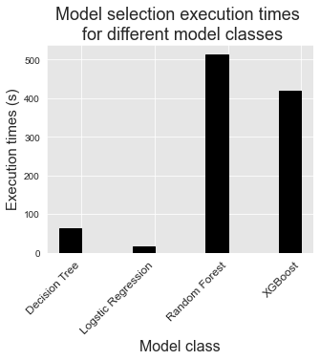
Real world considerations
Although XGBoost is the best performing model (on this dataset), it is also computationally intensive.

Slide 30
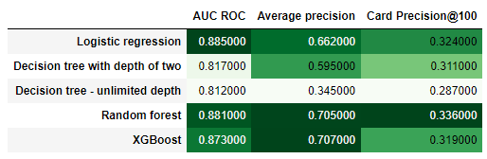
Other possible metrics
Card Precision top-kk
The Machine Learning Group - Card Precision top-k is a more pragmatic and interpretable measure.
It considers the fact that investigators can only check a maximum of k potentially fraudulent cards per day.
Notes:
A common approach to circumvent this conflicting goal is to assess the recall and false positive rates for all possible decision thresholds. The resulting function is the Receiving Operating Characteristic (ROC) curve. The area under the ROC curve (known as AUC ROC) is the most widely used metric to assess the performance of fraud detection systems. This chapter highlighted that the AUC ROC is however poorly adapted to class imbalanced problems such as fraud detection. Two other metrics, the Average Precision (AP), and the daily Card Precision top-kk (CP@k) were motivated to better characterize the performances of a CCFD.
The AUC ROC, AP, and CP@k are complementary. The AUC ROC reflects the accuracy of the detection system for all possible thresholds. The AP also reflects the accuracy of the detection system for all possible thresholds but gives more importance to regions of the decision thresholds where the precision remains high. Finally, the CP@k provides a more concrete metric for CCFD, by assessing the average daily precision of the system, assuming that a maximum of kk cards can be checked daily by investigators.

Slide 31
Final word
This is an area where machine learning techniques are still being explored! (Neural Networks)
The Machine Learning Group – testing on real world dataset and produced similar conclusions – RF & XGBoost.
Notes:
our real-world data are e-commerce transaction for Belgium, from 2018
https://fraud-detection-handbook.github.io/fraud-detection-handbook/Chapter_4_PerformanceMetrics/Assessment_RealWorldData.html

Slide 32
The END

Slide 33
References
(in order of appearance)
https://www.statista.com/statistics/1028439/singapore-most-popular-payment-methods-for-online-purchase/
https://www.straitstimes.com/singapore/courts-crime/at-least-21-people-in-singapore-fall-prey-to-transnational-online-credit-card
https://www.police.gov.sg/media-room/news/20210506_woman_arrested_for_unauthorised_transactions_using_stolen_credit_card
https://mothership.sg/2021/06/dbs-credit-card-fraud-bypass-otp-sms/
https://www.kaggle.com/mlg-ulb/creditcardfraud
https://fraud-detection-handbook.github.io/fraud-detection-handbook/Foreword.html#authors
https://fraud-detection-handbook.github.io/fraud-detection-handbook/Chapter_4_PerformanceMetrics/Assessment_RealWorldData.html

